Slide 1
Findtheroommate
Bella Yue
Jiqi Wang
Yufei Jin
Tengyue Hu
Rain Wang

Slide 2

Why should you care?

Slide 3



Why should you care?

Slide 4
Solution!
Findtheroommate
A web app for UCSB students to find the next great roommate.

Slide 5









Features

Slide 6
Live demo time!
http://phil492.pythonanywhere.com/

Slide 7
Email
Search
Edit/del
Comment
Product Evolution
MVP
NOW
Future
Login
Make post
Home page
Profiles
Recommendation
Profile pic

Slide 8



Architecture

Slide 9
Architecture
Routes
Templates
forms
Database
Jinja2
flask_wtf
flask_sqlalchemy
Login
Post
Search
Database migration
flask_migrate

Slide 10
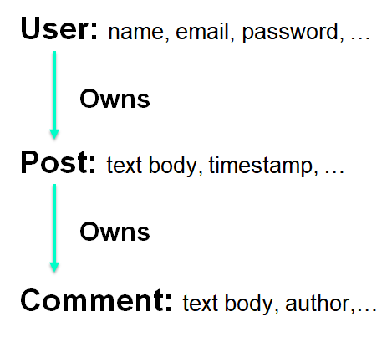
DataBase Structure:

Slide 11

Challenges
●Try to combine firebase with flask
○New Implementation (SQLAlchemy)
New concepts (Email validation)
Security Issues
Google, StackOverflow

Slide 12


What we have learned
● Solid foundation for web app
● Self-learning
● The power of team cooperation
● A great team!

Slide 13

Features Recap
A web app for UCSB students to find the next great roommate.
●Email Support
●Post and comment
●User profile
●Visit other users through posts
●Search

Slide 16
To Do List:
●Email Confirmation for post’s email
●More communication methods
●Follow
●Quick login
●More personalized profile
●Advanced Search
●Emoji
●User Recommendation
●…

Slide 17
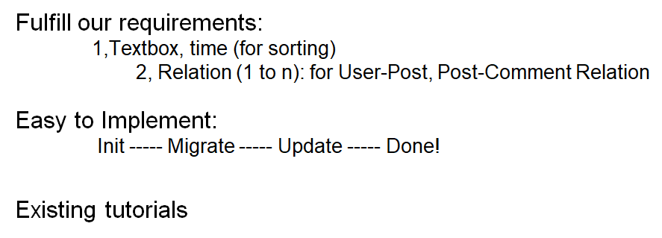
Why SqLalchemy:

Slide 18
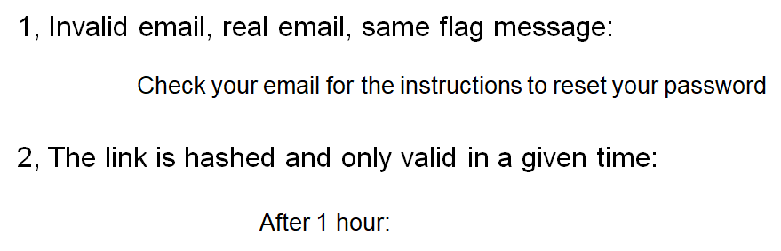
Security Feature:

Slide 19
Security Feature Cont.
●Can’t edit profile, posts, comments of other user (even by changing link)
(You will be redirected to home page!)
●You can’t post without confirming email
(But you can view posts and profile)

